Slide 1
High resolution hologram reconstruction based on integral imaging
2011-06-09

Slide 2
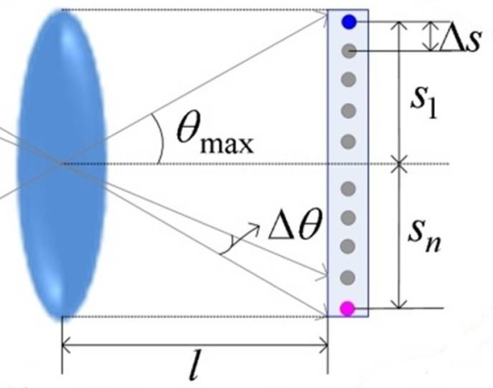
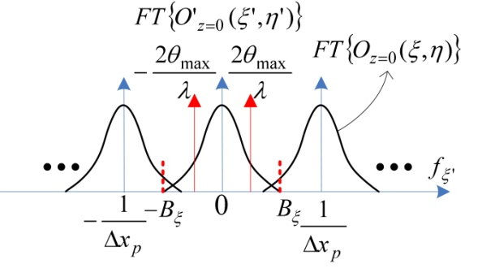
Resolution limitation of reconstruction
Size of reconstructed object
Spatial frequency domain representation

Slide 3
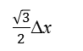
Sampling
Δy
y
Δx
y
Δy
Δx
$\frac{\sqrt{3}}{2}$Δx
Δx
x
x
Sampling of the object with rectangle lens array
Sampling of the object with hexagonal lens array

Slide 4
Orthographic image generation
×
=
mask
Image area contain one element image
Separated element image
Preprocess of element images
y
zero padding
x
Interpolation of orthographic images

Slide 5


Simulation
1mm
1mm
object
Sub lens of lens array
Specification of simulation
 | Pixel pitch | Pixel count | Focal length
object | 0.1mm | 512x512
Lens array | 1mm |  | 3mm
Element images | 0.02mm | 5000x5000

Slide 6
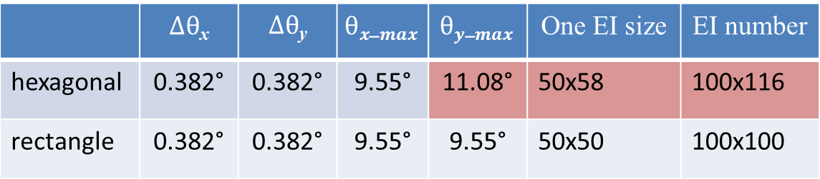
Simulation
Values of parameters that affect the resolution
 | $Δθ$_{x} | $Δθ$_{y} | $$θx_max$$ | $$θy_max$$ | One EI size | EI number
hexagonal | 0.382° | 0.382° | 9.55° | 11.08° | 50x58 | 100x116
rectangle | 0.382° | 0.382° | 9.55° | 9.55° | 50x50 | 100x100

Slide 7



Simulation
×
=
Part of preprocessed element Images
Element Images

Slide 8
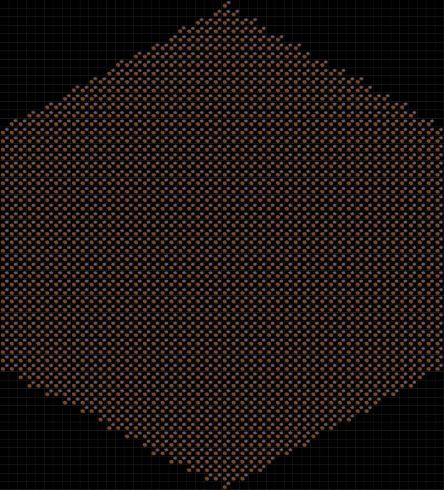
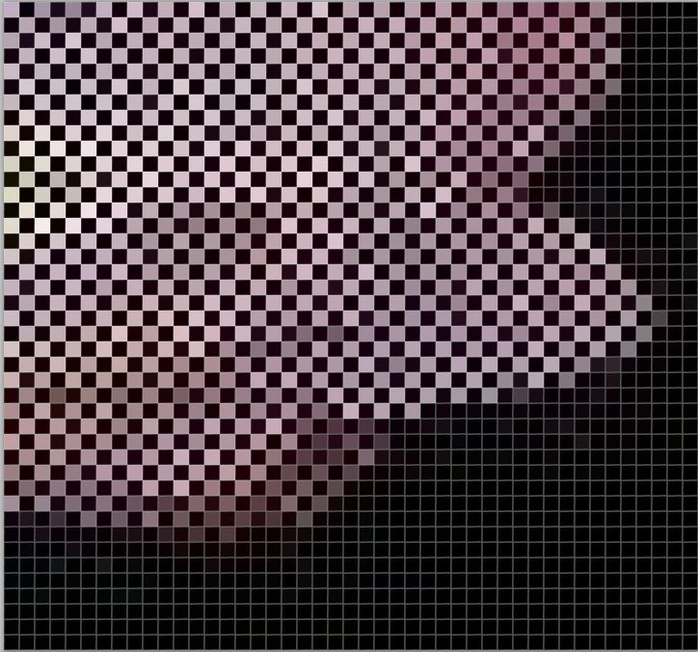

Simulation
y
x
Orthographic Images

Slide 9
Simulation
z=5mm
z=15mm
z=25mm
z=35mm
z=45mm
Reconstructed Images

Slide 10
Simulation
Hexagonal lens array
Rectangle lens array
Comparison of reconstructed Images

Slide 11
Experiment
Problems:
Each element image doesn’t have the same number of pixels.
Containing…

Slide 13


Hexagonal
18p
30p
Δy
18p
50p
1mm
Δx
六边形个数：
X: Nx/ Δx
Y: Ny/ Δy+1
$$\sqrt{3}/2$$
Δx= Δx_{p}
Δy= cos(π/6) ×Δx_{p}
×
=

Slide 14
y
$\frac{\sqrt{3}}{2}$p
$$\frac{p}{2}$$
x
(a)
(b)

Slide 15
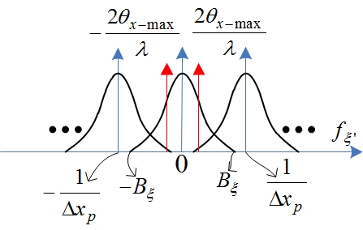
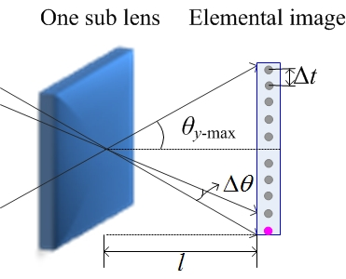
(a)
(b)

Slide 16
sampling
y
Δy_{p}
Δx_{p}
x
y
Δy_{p}
Δx_{p}
x

Slide 17
y
y
Δy
Δx
Δy
Δx
x
x
(a)
(b)

Slide 18
sampling
y
Δy_{p}
Δx_{p}
x
y
Δy_{p}
Δx_{p}
x

Slide 19
sampling
f_{y}
f_{y}
f_{x}
f_{x}
(a)
(b)

Slide 20
sampling
f_{y'}
f_{y'}
f_{x'}
f_{x'}
(a)
(b)
f_{y}
f_{y}
f_{x}
f_{x}
(a)
(b)

Slide 21
sampling
f_{y}
f_{y}
f_{x}
f_{x}

Slide 22
sampling
f_{y}
f_{x}
f_{y}
f_{x}

Slide 23
v
v
u
u
(a)
(b)

